Slide 1
How to buy the right computer for you
Save money & get a better computer

Slide 2
Preparation
Price Range
Usage
Portability
Expected Life Span
Operating System
Features

Slide 3
Price Ranges
$800+
Sub $500
Sub $800
Why don't you just buy a car $
$3500+

Slide 4
Usage
E-mail & Internet
Storing & Organizing Photos/Videos/Music
Professional Photo/Video Editing
Gaming
?

Slide 5
Portability
Netbook
Laptop
Desktop

Slide 6
Life Span
“As new waves of computer models get introduced
the average new computer becomes obsolete within 18 months,
the trend is toward cheaper materials.”
newsreview.com
“planned obsolescence”

Slide 7
Operating System
 | Macintosh OSX | Windows XP/Vista | Linux
Pre-installed Software | iLife Safari Mail | Internet Explorer Outlook Express Minesweeper, etc. | Open Office Firefox Misc. Games
Ease of use | Very Easy | Easy to use, Not as much as OSX | Fairly Difficult
Upgrade-ability | Little to none | Most parts can be upgraded | Most parts can be upgraded
Price | New – Free Upgrade - $129 | New – Free Upgrade - $100-500 | Free always
Customer Support

Slide 8
Features
Blu-Ray
CD/DVD Burner
Video out
USB/Firewire ports
Screen size
Keyboard Quality
Audio out/in
Slots for different
media cards:
SD, xD, etc.
Battery life

Slide 9
Now to customize...
-Memory
-Hard Drive
-Processor
-Video Card

Slide 10
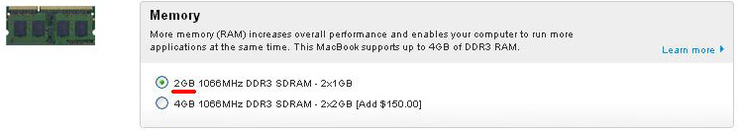
Memory (RAM)
Random Access Memory
More = faster program startup times
Generally easy to upgrade
“RAM is temporary storage, where the processor does its work, where programs run, and where information is stored while it's being worked on.”
-Yahoo! Tech

Slide 11
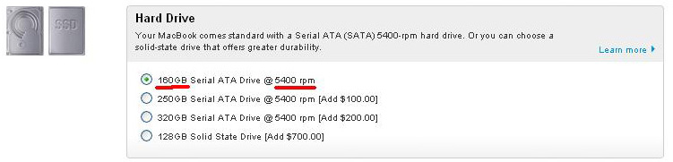
Hard Drive
Stores everything on your computer (music/pictures/etc)
Larger RPMs increase overall speed

Slide 12
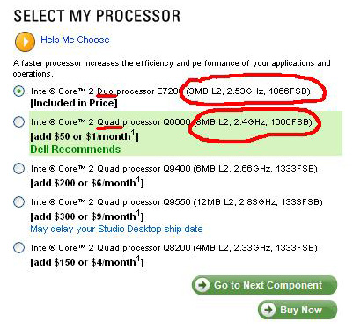
Processor
Larger GHz means faster programs
More cores mean more programs can run at the same time at the same speed
“The faster the speed of your processor, the faster your PC will perform.”
-Yahoo! Tech

Slide 13
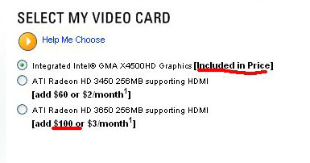
Video Card
Essentially RAM dedicated to video
More expensive / more MBs the faster
Needed for gaming or video editing
“The better the chipset, the faster and the more realistic 3-D graphics that your PC can produce.”
-Yahoo! Tech

Slide 14
General Tips
Most computer companies have sales on major holidays and during the summer before school. You can save hundreds of dollars by waiting to buy your computer then
Reliable Brands:
Apple
Lenovo
Above Average Brands:
Dell
HP
Acer
The most difficult item to upgrade is the CPU.
If you are going to spend extra money on something spend it on the CPU.
Before buying, see if the brand you are buying from has any press events planned. New products with improved parts and features are generally announced there.

